Slide 1
RGBD Cameras’ Per-Pixel Calibration and Natural 3D Reconstruction on GPU
Dr. Lau, advisor
Dr. Hastings, committee member
Dr. Cheung, committee member
Presented By: Sen Li

Slide 2
Outline
Introduction
Academic Background:
Pinhole Camera Model (Camera calibration / 3D reconstruction)
Kai’s per-pixel 3D reconstruction on GPU
Distortions
Per-Pixel Distortion Correction & Natural GPU Reconstruction:
Calibration system
Calibration procedures
Undistorted 3D Reconstruction
Conclusion & Future Work

Slide 3
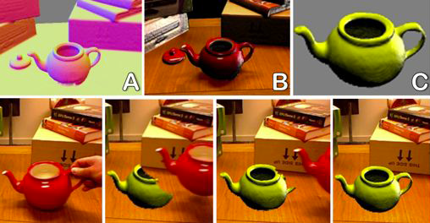
Object Segmentation in KinectFusion

Slide 4
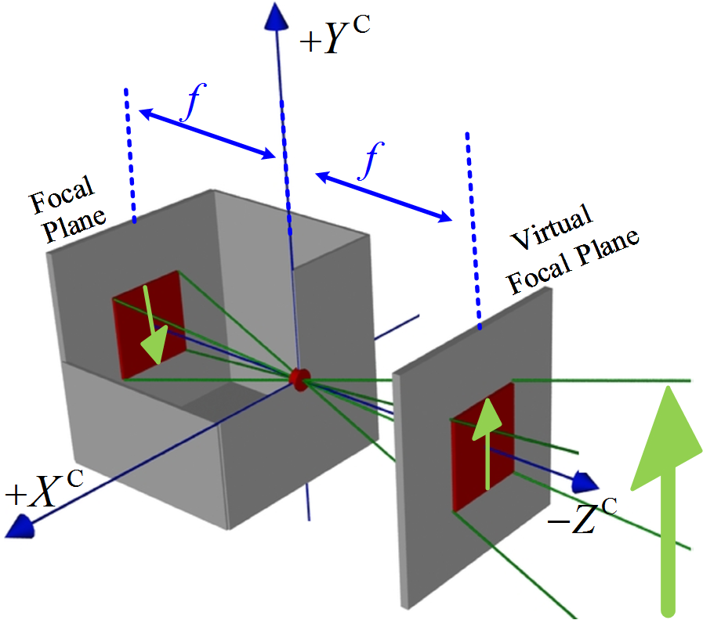
Pinhole-Camera Model

Slide 5
Pinhole-Camera Model

Slide 6
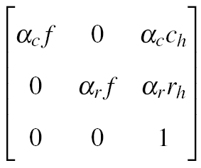
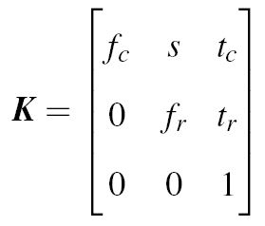
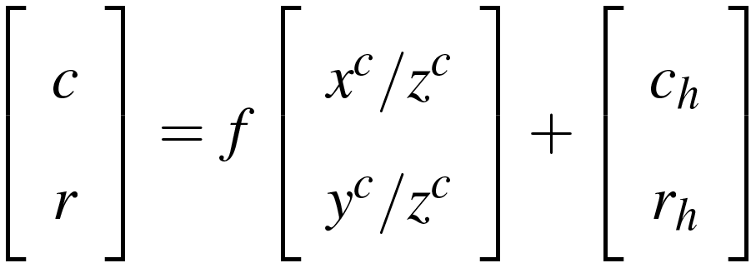
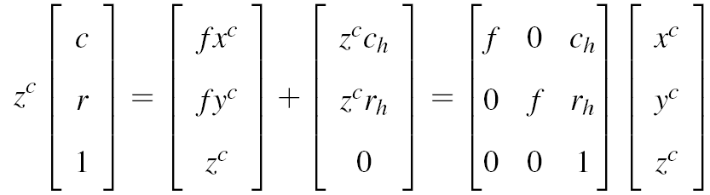
Pinhole-Camera Model

Slide 7
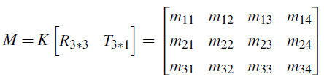
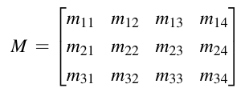
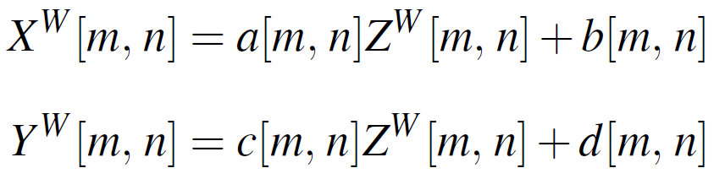
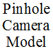

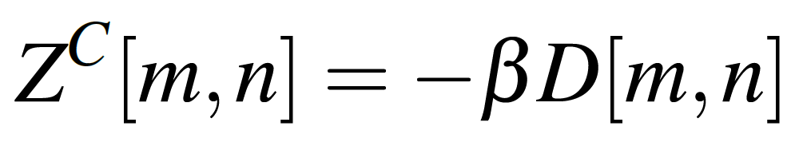
Traditional Reconstruction
(Calibrate M and then Inverse)
Kai’s : Natural Shader Reconstruction on GPU
KinectV2: Raw 3D Reconstruction on GPU based on (Intrinsic K)

Slide 8
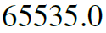
Raw 3D Reconstruction on GPU based on (Intrinsic K)

Slide 9
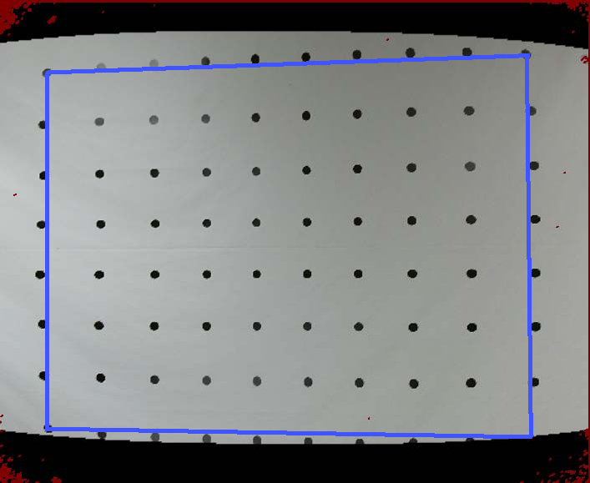
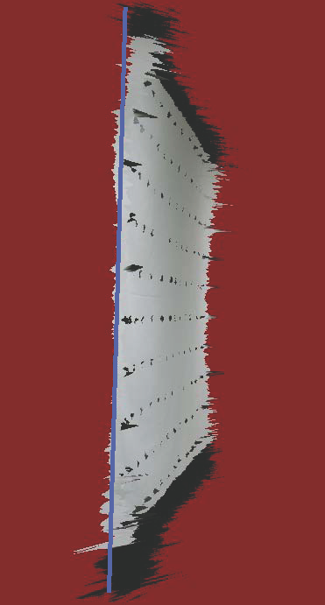
Raw KinectV2 3D Reconstruction
lens Distortion
Depth Distortion

Slide 10
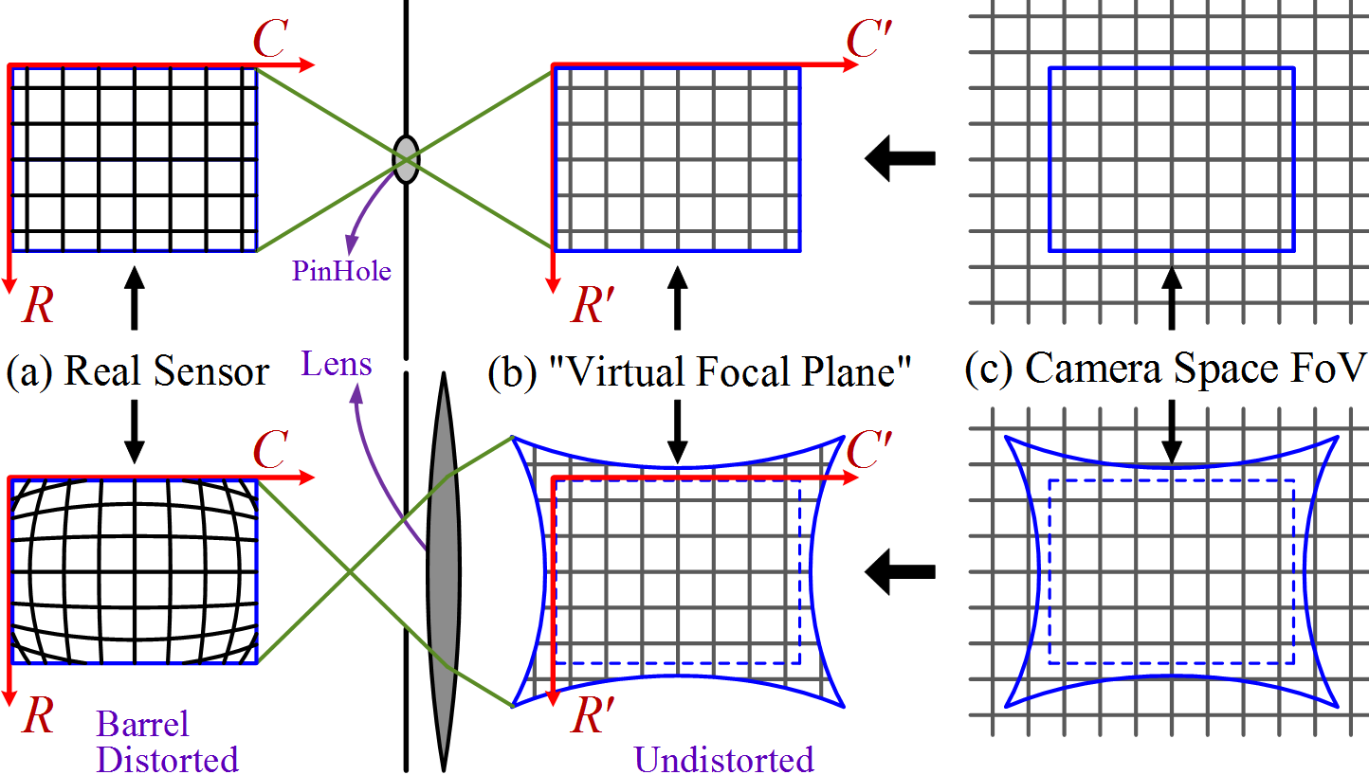
From Camera Space to Image Space with Lens Distortions

Slide 11
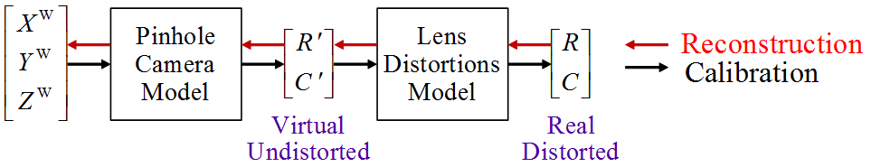
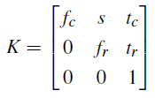
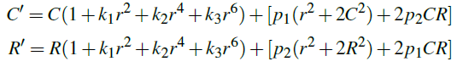
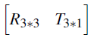
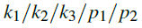
Academic Background
Pinhole-Camera Model
(Calibration and Reconstruction)
Intrinsic Matrix
Distortion Parameters:
Extrinsic Matrix
Pinhole Camera Matrix :
Notes:
Note that, in Kai’s work only offers an inspiration for parallel processing, did not offer a complete calibration method, because he did not offer the method to get Zw.

Slide 12
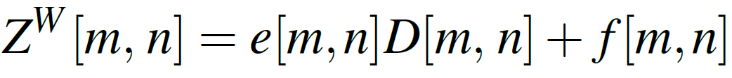
Traditional Undistorted Reconstruction
(High Order and Inverse)
Distortion Parameters:
Kai’s : “Natural” Shader Reconstruction ( High Order )
Want: Undistorted Natural 3D Reconstruction on GPU
Inspiration: find a way to get per-pixel

Slide 13
Rail Calibration System

Slide 14
Data Collection
Mount: camera and laser distance measurer
Want:
NIR:
RGB:
Bound:
: Laser Distance Measurer
: Uniform Round Dot Pattern
Found (algorithms):
Calibration Points (Row, Col)s Extraction;
Corresponding World Space Address Assignment;
Non-Linear Dense Transformation

Slide 15
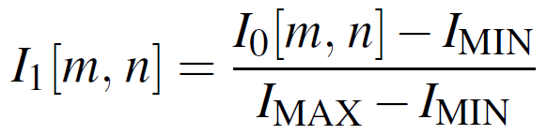
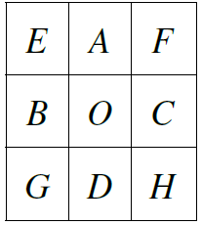
Calibration Points (Row, Col) Extraction;
Gray-Scaling (luminosity method)
Histogram Equalization
Adaptive Thresholding
Round Dot Tracking

Slide 16
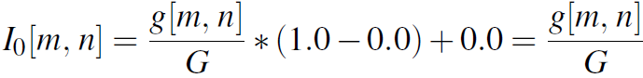
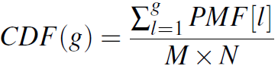
Raw NIR Image
After Historgram Equalization

Slide 17
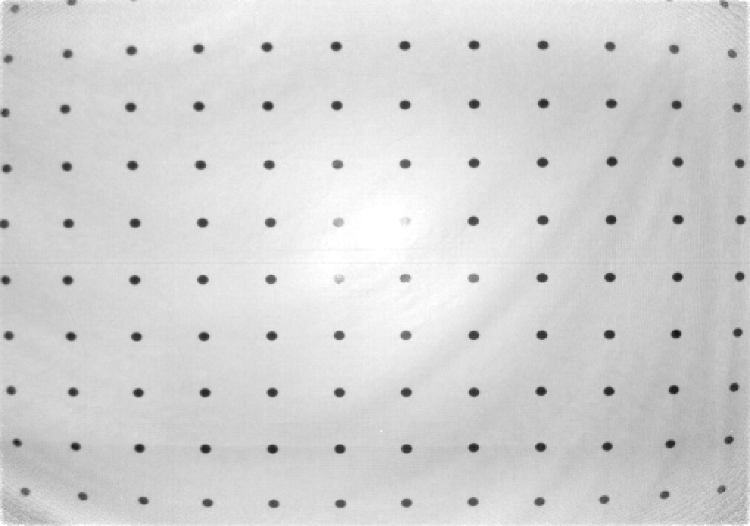
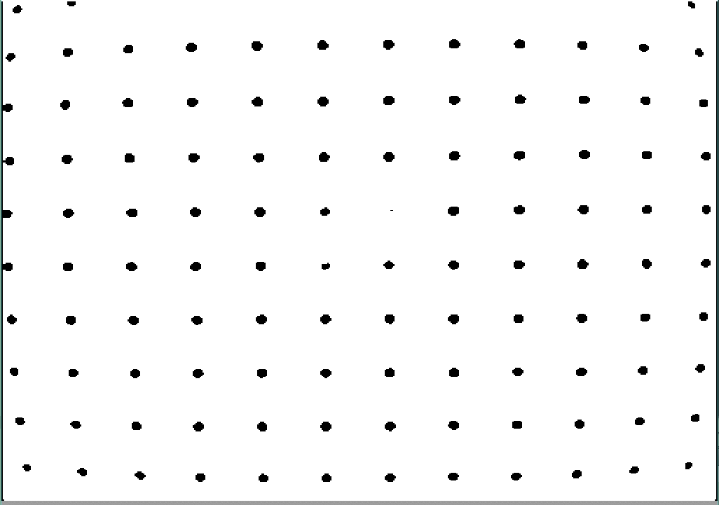
Adaptive Thresholding
Historgram Equalized
Binarized

Slide 18
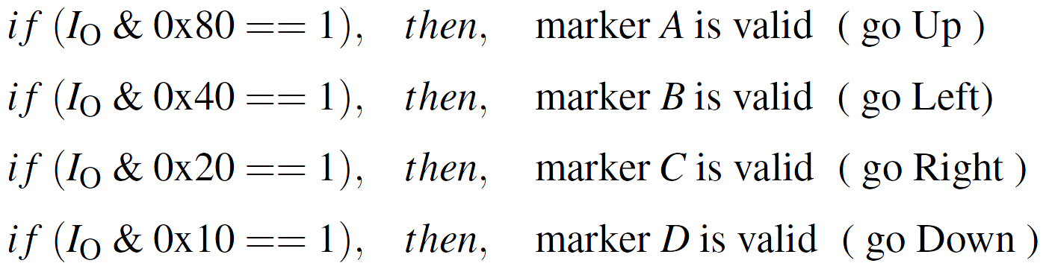
Round Dot Tracking
Anchor !=0 → Detect Valid → Flip Valid → Get Area + Bounding Box

Slide 19
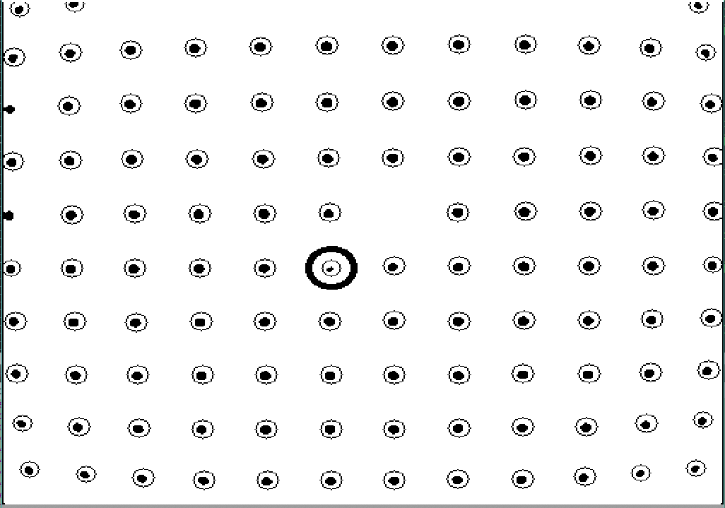
Traverse and Extract on CPU
Binarized Image
Dots’ Centers Extracted

Slide 20
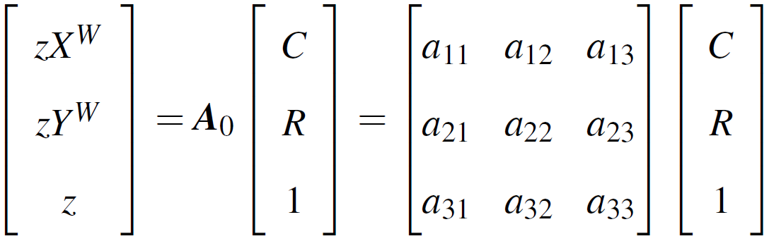
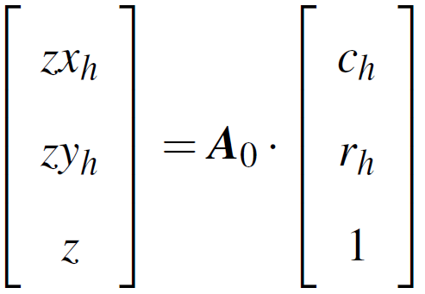
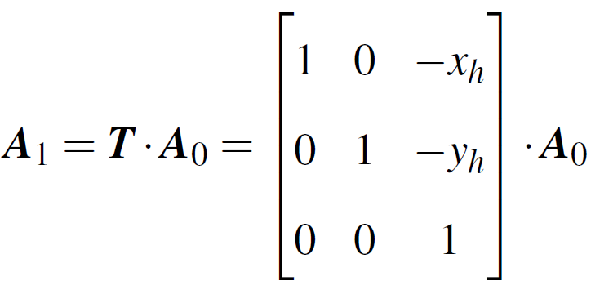
World Space Address Assignment
• Travers every 4 Square-Shaped points and find best A₀ ,
which corresponds to the best-fit “Unit One” (228mm) in Image Space:
Get Linear Mapping matrix A₀ → Transform all (R, C) to (X^{W}, Y^{W})
→ Count (N_{v}) valid points with integer X^{W}/Y^{W} → Find best A₀ who generates the largest N_{v}.
Translate Origin to the Center Dot

Slide 21
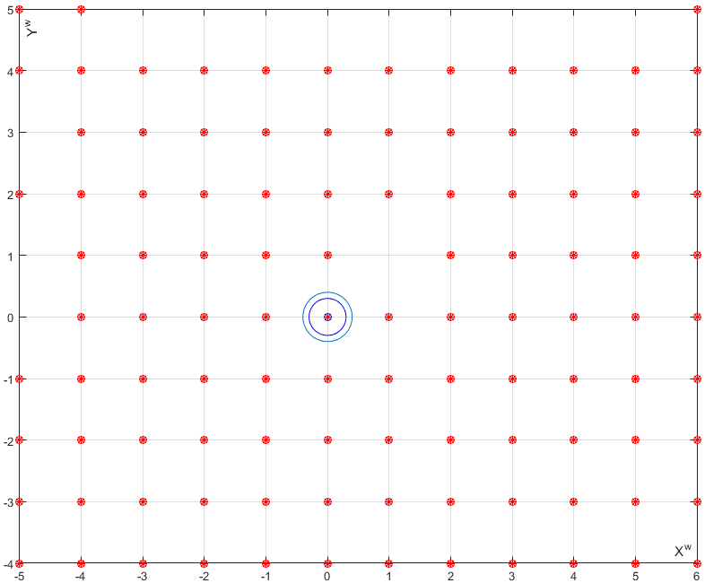
World Space Address Assignment
Image Space Calibration Points
Assigned World Space X^{w}Y^{w}

Slide 22
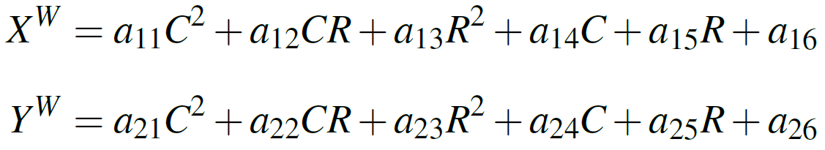
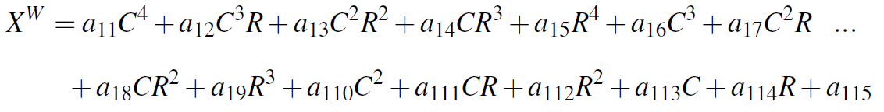
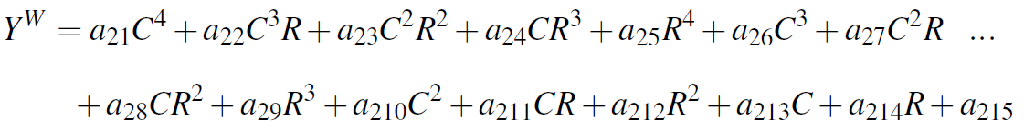
Two Dimensional Polynomial Mapping
(First Order Perspective Transformation)
Second Order
Fourth Order

Slide 24
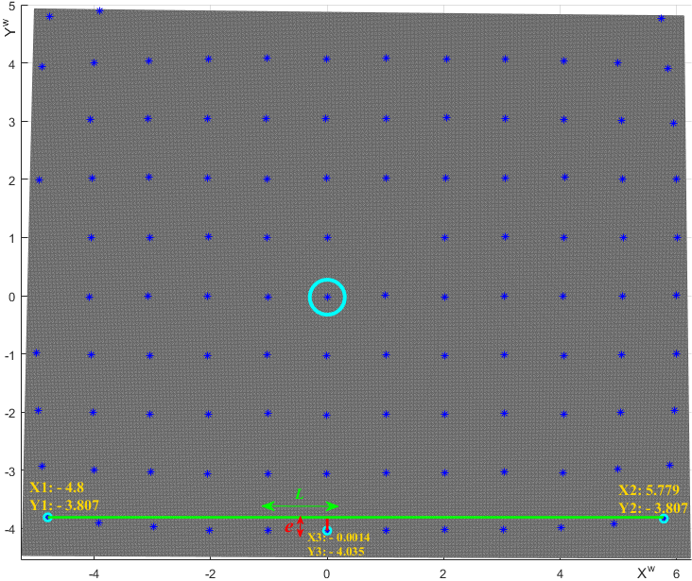
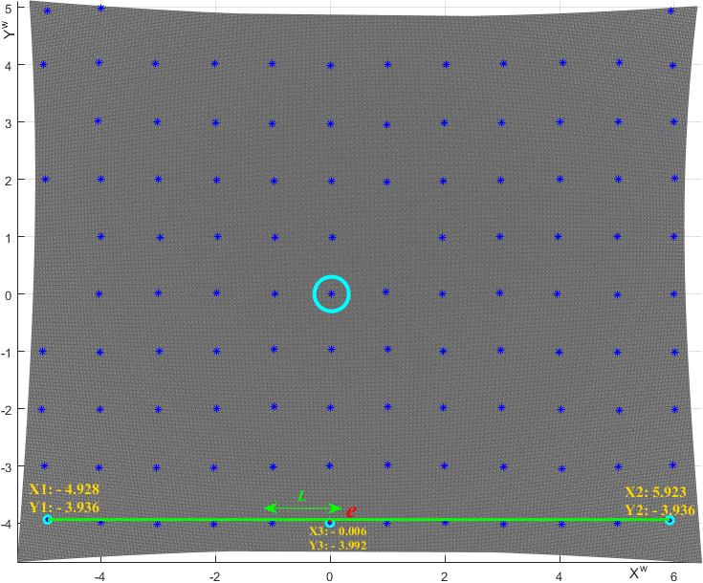

Slide 26
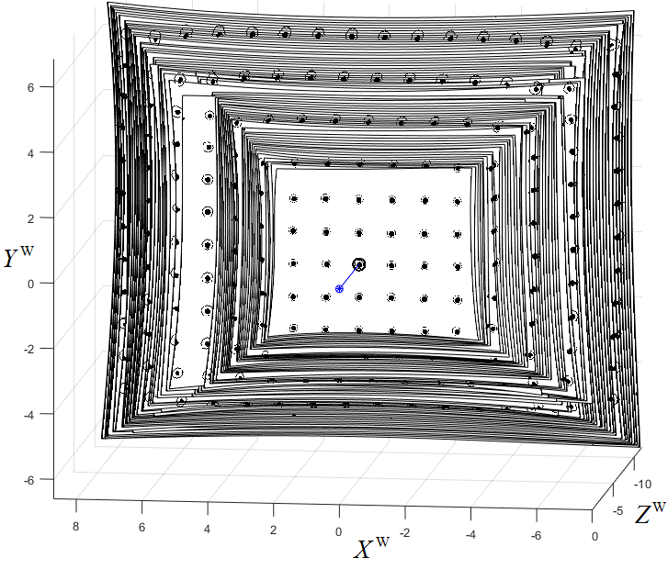
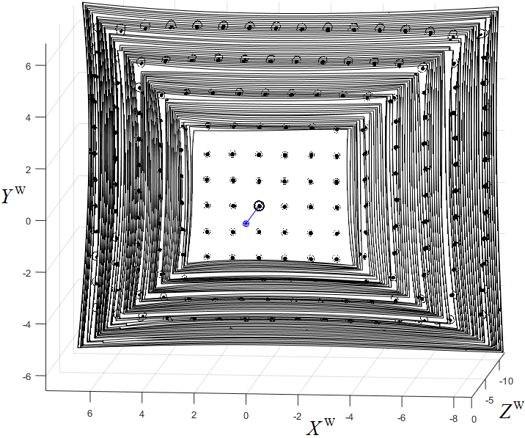
63 frames from 1.165m to 2.565m, 25mm / frame
Staggered
Unified

Slide 27
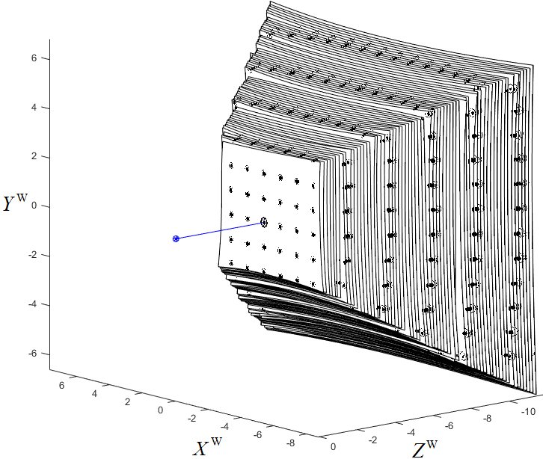
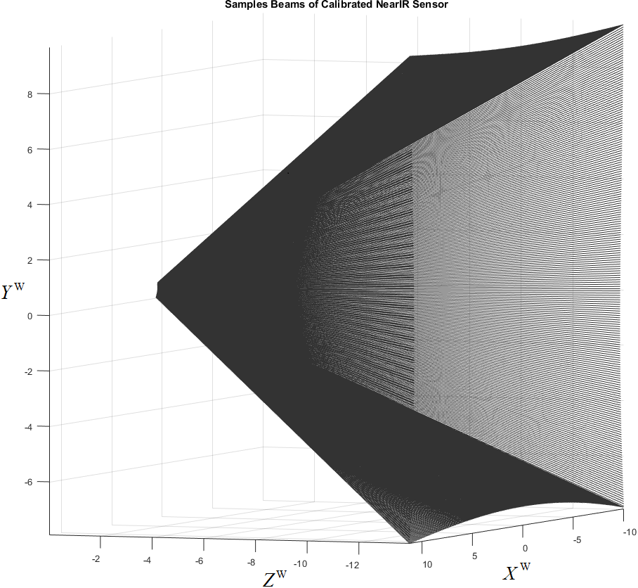
63 frames, generate Pixels’ Beam Equations
Frustum
Linear Z^{w} to X^{w}Y^{w} : Pixels’ View

Slide 28
Per-Pixel D to Z^{W} mapping
Data at pixel (212, 256)
from 32 frames
Linear in this example
D to Z^{W} Polynomial Fit

Slide 29
Generate Look-Up Table
Size: Width - Height - 6 (512*424*6)
Data:
Pre-Process: (for every frame)
Find best-fit plane equation
Throw away 10% pixels of worst D
Mappings:
Fragment Shader: 3 per-pixel linear mappings, 6 parameters

Slide 30
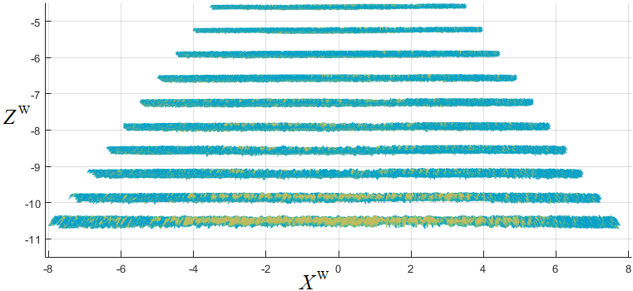
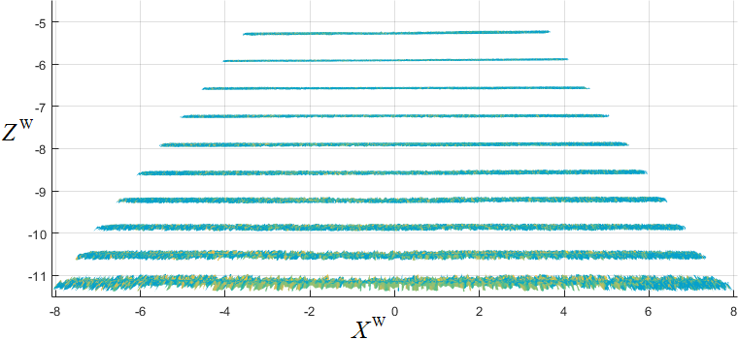
Depth Distortion Correction
Raw Pin-Hole Reconstructions
Transformed
into World Space
By
Best-Fit Rotation and Translation
Calibrated LUT Reconstructions

Slide 31
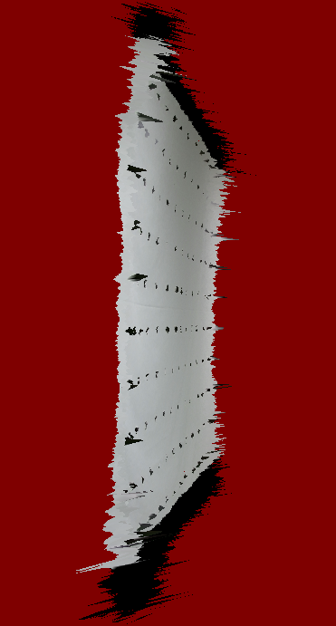
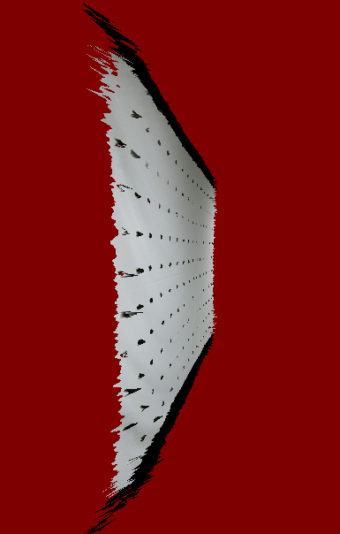
Before
Calibration
Calibrated

Slide 32
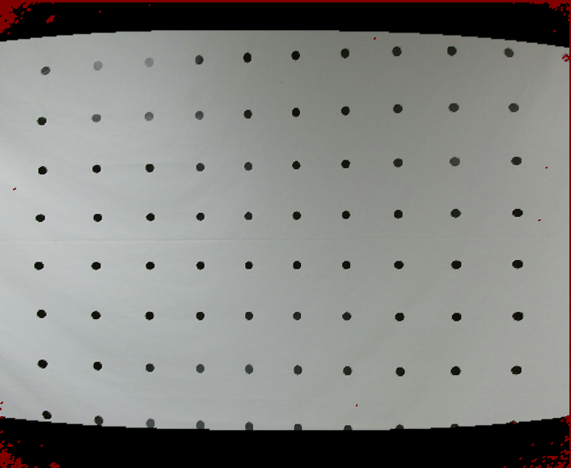
Lens Distortion Correction
Before Calibration
Calibrated

Slide 33
Conclusion
Rail System
Infinite frames of data, dense calibration points, per-pixel D to Z^{W} mapping
Data Collection (Per-Frame)
Get Z^{W} from laser distance measurer ;
Robust calibration points’ extraction ;
Histogram Equalization, Adaptive Thresholding, Round Dots’ Tracking
Assign world space coordinates to calibration points ;
Determine two-dimensional fourth order polynomial mapping ;
Generate dense undistorted X^{W}Y^{W} .
Pre-Process
Unify staggered frames
Throw away 10% noise pixels
Generate LUT: Width - Height - 6 (512*424*6)
3D Reconstruction: Undistorted 3D Reconstruction, No model, Only Textures

Slide 34
Future Works
Hard Ware
Longer rail: segmented D to Z^{W} mapping in case a rough extrapolation;
Pattern Size and Distribution: based on resolution ;
2D pattern to 3D pattern: in case NIR streams cannot be used, 3D pattern for depth streams analysis ;
Tracking module on rail: to substitute laser distance measure, such that it is possible to input Z^{W} record frames automatically.
Software
Better DIP techniques ;
Higher order polynomial Z^{W} to X^{W}Y^{W} mapping.

Slide 35
Questions?

